Slide 1

Descriptive Analysis
2008
vs Present
SCALES OF THE TURMOIL?
SIMILARTIES?
BEGINNING OF A NEW GLOBAL CRISIS?

Slide 2
Silicon Valley Bank's situation in recent years
Short period of time
Incomplete strategy
Ignorance of change in interest rates
Panic and following massive withdraws

Slide 3












Credit Suisse's situation in recent years
Scandals: spying and cash laudering
Loose of crutial investors (Greensill and Archegos)
Top management changes
Long period of time in recession

Slide 4
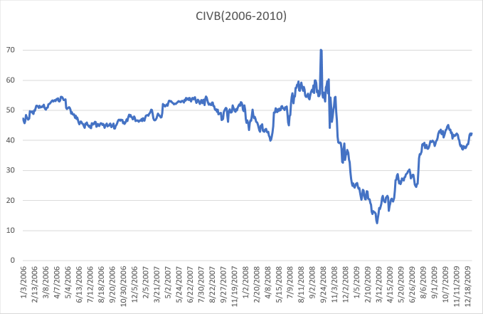
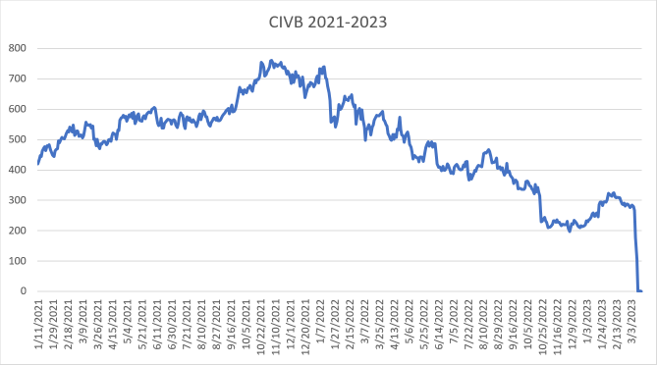
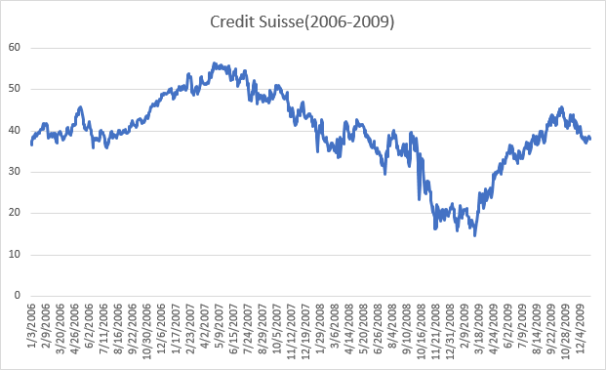
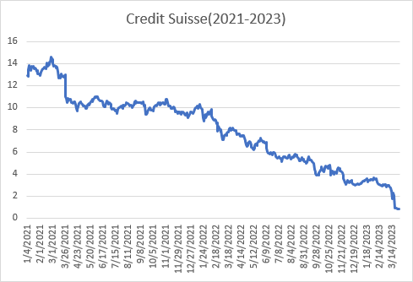
 | 2008 | Present
SVB
CS

Slide 5
Extern factors in 2008
Intern factors in present
Collapse almost at the same time
The housing boom burst
Globalization
All institutions were affected
Scandals
Poor strategy
Changes in management
Huge banks and those in interaction with these two banks
Low amount of liquid assets
A need for changes
A participation of governments
Bancruptcy

Slide 6

Any questions?

